Slide 1

The 8 Methods of Characterization
8 different ways of looking at a character in a story

Slide 2
1. Physical Description
The most common way of describing a character.
Identifies anything physical about the character.
Includes height, skin, hair and eye color, short/tall, skinny/fat, wear glasses?, how he/she walks/stands, anything physical about the character.

Slide 3

Example of physical description:
The soldier wears his dress blues for the event; shined black leather shoes that shone in the light, perfectly pressed pants and a jacket displaying his rank. He was a tall man that stood out in a room. Almost six foot seven inches, he towered over most of his peers.

Slide 4

2. Name Analysis
Analyzing a character’s name is looking more closely to it’s meaning (if there is one) and describing it.
Not all characters have a name with significance to the story.
A lot of times though, author’s carefully choose a character’s name to represent something about the character and/or the story.

Slide 5
Example of name analysis:
In the novel, That was Then, This is Now by S.E. Hinton you can analyze the name of the character M&M. M&M gets his nickname because of the fact that he is always seen eating the popular candy by the same name. The other characters of the story have called him this name so often that is commented that no one remembers his real name.

Slide 6

Example of name analysis con’t:
If you were to write a name analysis for the character M&M in S.E. Hinton’s novel you would explain in your description how the name has significance to the character.

Slide 7

3. Attitude/Appearance
This method of characterization is the readers description of the character’s attitude.
The character’s attitude is how the character appears to feel about what is happening to him/her in the story.
Similar to how you may describe your attitude if you were in a similar situation.

Slide 8

Example of attitude/appearance:
“She suffered constantly, feeling that all the attributes of a gracious life, every luxury, should rightly have been hers.” – “The Necklace” by Guy de Maupassant.
In this quote from the popular short story we learn that the main character’s attitude is one of resentment, feeling that she deserves a better life.

Slide 9
4. Dialogue
Dialogue is the way in which a character talks.
Dialogue includes the characters choice of words and syntax.
It also includes the tone and diction of the character when he/she speaks.
Is the character serious? Sarcastic? Shy? Obnoxious? Ignorant? Etc…all these qualities can be conveyed through the characters dialogue.

Slide 10
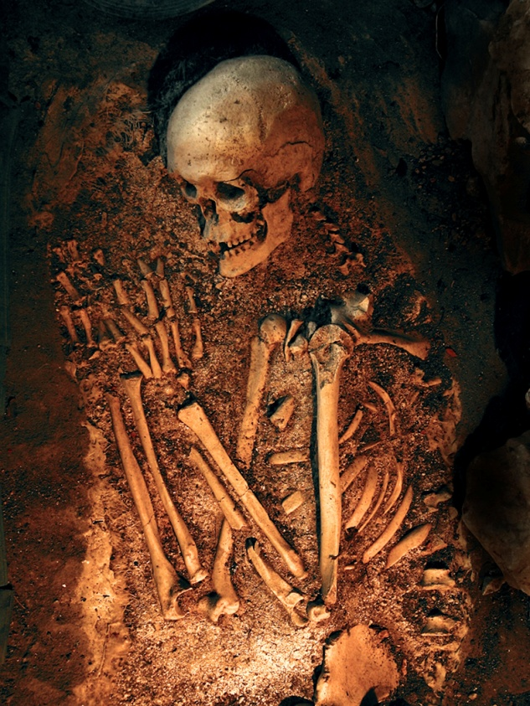
Example of dialogue:
“Come, we will go back; you health is precious. You are rich, respected, admired, beloved; you are happy, as once I was. You are a man to be missed. For me it is no matter. We will go back; you will be ill, and I cannot be responsible.” “The Cask of Amontillado” by Edgar Allan Poe

Slide 11
Example of dialogue con’t:
In this quote from the popular story by Edgar Allan Poe the narrator shows concern for Fortunato, the story’s antagonist.
We know that the narrator wants revenge on Fortunato. When analyzing the dialogue here we can infer that the narrator is being sarcastic.

Slide 12
5. Thoughts
The thoughts of a character can only be analyzed if we are inside the head of the character.
This means that you can only include an analysis of a character’s thoughts if you are told what the character is thinking.

Slide 13

Example of thoughts:
In the story, “The Secret Life of Walter Mitty” by James Thurber the reader is very much a part of Walter Mitty’s thoughts.
Through the descriptions in the story the reader experiences the daydreams of the character.
On the other hand, the reader cannot comment or analyze the thoughts of Mrs. Mitty since we are never “inside her head.”

Slide 14
6. Reactions of Others
When analyzing the reactions of others you are looking closely at how other characters in the story react to or treat the character that you are characterizing.
Reactions include verbal responses and physical or emotional treatment.
Character reactions can tell you if the character you are analyzing is liked or disliked, popular, honest, trust-worthy etc…

Slide 15
Example of Reactions of others:
In a story the way other characters interact with each other can reveal a lot about the characters. In the story “The Secret Life of Walter Mitty” by James Thurber, Walter’s wife treats him with an almost boss-like motherly attitude rather than a loving wife. This reveals to the reader that his wife finds him to be incompetent or unable to accomplish things on his own.

Slide 16
7. Action or Incident
A character can be analyzed by looking at an action or incident and how it affected them or how they reacted to it.
What action did the character take when confronted with a certain situation.
Is there and incident in the characters past that has shaped them as a character and affected the way they look at their life.
The action or incident determines the way the character develops as the story goes on.

Slide 17
Example of Action or Incident:
In the novel, The Outsiders by S.E. Hinton we learn that the narrator lost his parents in a car accident when he was young. This accident happened before the story began and is affecting the development of the main character. In a character description you could explain how this incident affects the characters development and give examples of its effect.

Slide 18


8. Physical/Emotional Setting:
The setting of a story affects the characters’ development as well as the plot.
The physical setting of a story is where the story is actually taking place and can effect the way a character develops.
The emotional setting of a story is the series of emotions that the character deals with throughout the story.

Slide 19
Using the 8 methods to describe a character
Use the these 8 methods of characterization when writing a description of a character in the stories you read. By looking at all 8 methods you can give an in-depth description of the character instead of a flat description that includes only basic information.

Slide 20
Presentation created by
Trish Turner
2008

